Slide 1
Sociology: 3549 Standardized distribution
Recitation #4
Yue Chu

Slide 2
announcement
Homework #1 is being graded.
Homework #2 has been distributed.
Homework 2 is due Oct. 23.

Slide 3
agenda
Review of lecture
Activity
Normal distribution
Standardize distribution
In class exercise
Type your answer to Carmen for attendance
Stata

Slide 4
Commonly observed bell-shaped distribution
Examples: weight, height, IQ, sum of two dices, blood pressure, …

Slide 5

Normal distribution
A theoretical model of frequency distribution
Symmetric, uni-modal, smooth, bell-shaped curve, ($−∞,∞$)
Normal distribution is also called Gaussian distribution
Carl Friedrich Gauss discovered the math formula (and used it in astronomy)

Slide 6
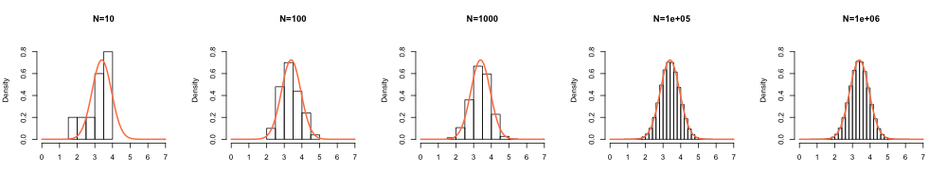
Theoretical probability distribution
Theoretical: distribution based on infinite population
As sample size increases, the probability distribution gets closer to smooth, bell-shaped curve – normal distribution.

Slide 7
DEFINING NORMAL DISTRIBUTION
Mean and standard deviation determines the shape and probabilities entirely
About 68.2% of observations are within the range -1 to 1 standard deviation.
About 95.5% of observations are within the range -2 to 2 standard deviations.
About 99.7% of observations are within the range -3 to 3 standard deviations.

Slide 8
DEFINING NORMAL DISTRIBUTION
Mean and standard deviation determines the shape and probabilities entirely
Quiz question: __% of observations are lower than 2 SD above the mean?
Notes:
97.72%

Slide 9
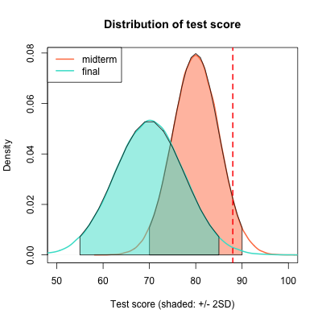
standardization
Why do we standardize data?
Test score example
Midterm: Mean = 80, SD = 5
Final: Mean = 70, SD = 7.5
A student scored 88 in both mid-term exam and final exam.
What would you say about the student’s performance?

Slide 10
Z-score
A way to identify and describe relative location of a score within distribution
A standardized score that indicates the direction and distance, in standard deviation units, of a particular value from the mean
Indicates the degree that any given raw score deviates from the mean of a distribution on a standardized scale
Z score is transformed value of raw data
Is measured according to a set metric
is more easily compared to other scores
Notes:
How do we interpret the standardized mean and standard deviation?
Why do the unstandardized and standardized mean and standard deviations differ from one another?

Slide 11
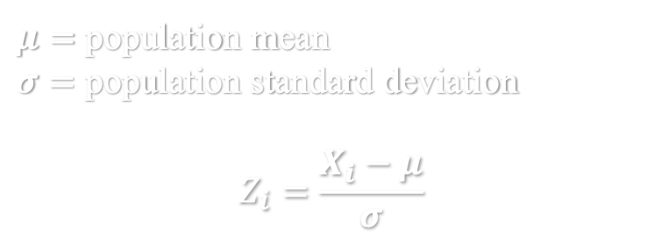
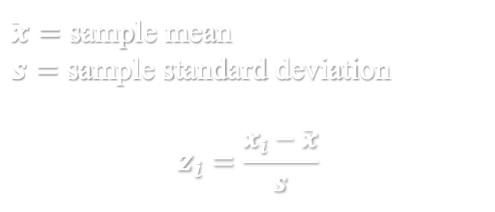
Calculation of z-score
For a population: For a sample:
$μ=$ population mean
$σ=$ population standard deviation
$$Z_{i}=\frac{X_{i}−μ}{σ}$$
$\overline{x}=$ sample mean
$s=$ sample standard deviation
$$z_{i}=\frac{x_{i}−\overline{x}}{s}$$
Interpretation
Sign:
positive z score indicates greater than mean;
negative z score indicates less than mean.
Values:
How many STANDARD DEVIATIONS raw score is from mean (center of distribution)
Notes:
Convert the variance back to original metric

Slide 12
Standard normal distribution
Standardized normal distribution
Transform every value from normal distribution to z-score
Mean = 0 , SD = 1
It’s also called Z-distribution

Slide 13
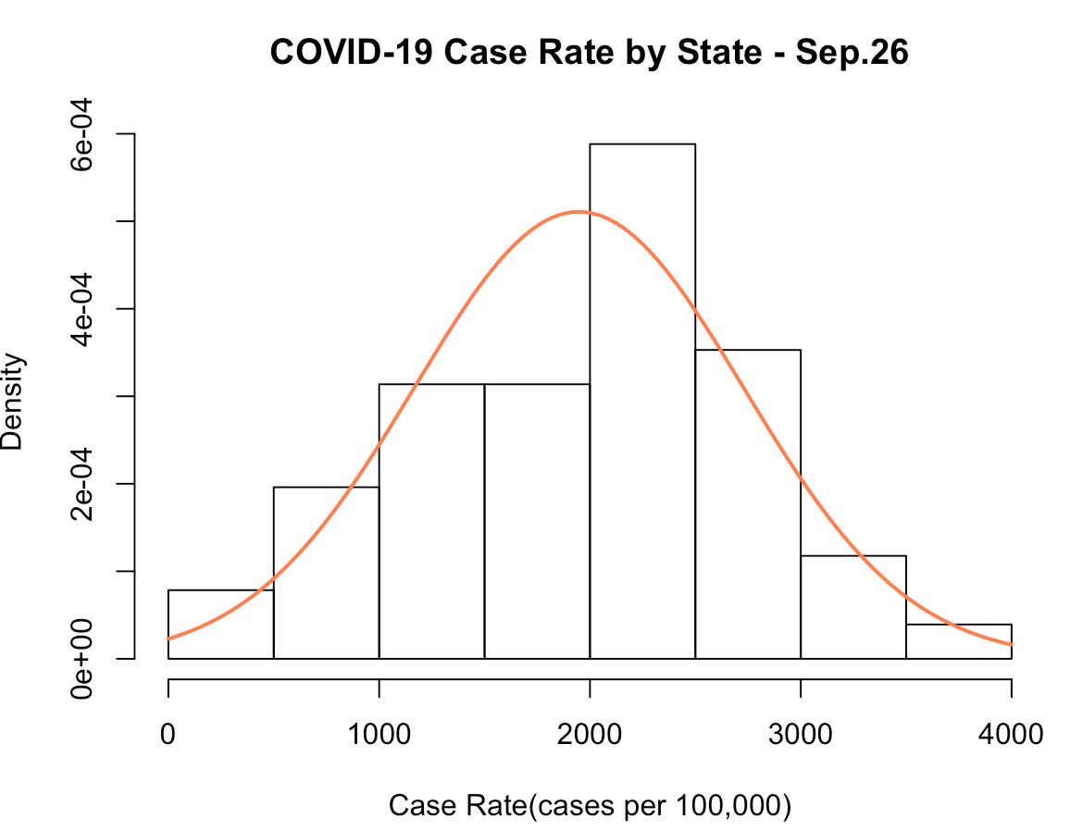
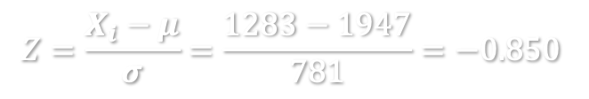
Example #1
Case Rate for Ohio is 1283 cases per 100,000 population.
Mean case rate of all states:
Mean case rate: 1947 cases per 100,000
Standard deviation: 781
💡Q: Calculate the z-score and interpret
Ohio
Treat all states as a population
The case rate for Ohio is 0.850 standard deviation below the mean case rate for all states.
$$Z=\frac{X_{i}−μ}{σ}=\frac{1283−1947}{781}=−0.850$$

Slide 14
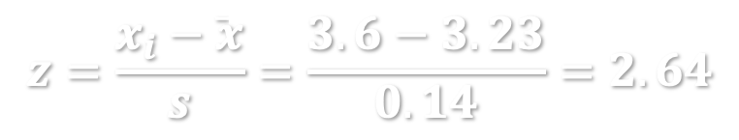
Example #2
The World Health Organization (WHO) releases international growth standard distribution, to help doctors and parents to assess whether children are growing and developing as they should.
For girl in US, mean of birth weight = 3.23 kg, SD of birth weight = 0.14kg
What is the z-score for a girl born at 3.6kg?
The growth standard is determined based on a sample
The birth weight for this girl is 2.64 standard deviation above the mean birth weight for girls in US.
$$z=\frac{x_{i}−\overline{x}}{s}=\frac{3.6−3.23}{0.14}=2.64$$

Slide 15
In-class exercise
Test score example
Midterm: Mean = 80, SD = 5
Final: Mean = 70, SD = 7.5
A student scored 80 in both mid-term exam and final exam.
Calculate the z scores and interpret.
Type your answer in Carmen Assignment – Lab attendance Sep.28

Slide 16
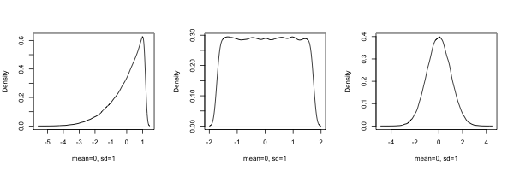
A few clarifications
Q: All normal distribution has mean = 0 and SD = 1?
Q: If a distribution has mean = 0 and SD = 1, does it mean it is definitely a standard normal distribution?
Notes:
All normal distribution has mean = 0 and SD = 1?
FALSE. Only standard normal distribution has mean = 0 and SD = 1.
If a distribution has mean = 0 and SD = 1, does it mean it is definitely a standard normal distribution?
FALSE. Normal distributions are theoretical distributions that are formally mathematically defined. They are symmetric, unimodal, bell-shaped etc… that might not be guaranteed by just knowing the mean and SD.
Standardizing the variable makes the variable “normal” ?
FALSE. Standardizing the variable doesn’t change the distribution of the variable. Standardization does not mean normalization.

Slide 17
A few clarifications
Q: Can you only ”standardize” a normally distributed variable?
Q: Does standardizing the variable make the variable “normal” ?
Notes:
All normal distribution has mean = 0 and SD = 1?
FALSE. Only standard normal distribution has mean = 0 and SD = 1.
If a distribution has mean = 0 and SD = 1, does it mean it is definitely a standard normal distribution?
FALSE. Normal distributions are theoretical distributions that are formally mathematically defined. They are symmetric, unimodal, bell-shaped etc… that might not be guaranteed by just knowing the mean and SD.
Standardizing the variable makes the variable “normal” ?
FALSE. Standardizing the variable doesn’t change the distribution of the variable. Standardization does not mean normalization.

Slide 18
Now let’s do this in Stata.

